Slide 1
Abnormal Psychology
Cognitive, Substance-Related, Schizophrenia and Other Psychotic Disorders
Lloyd Toni Enriquez, RPm, RPsy

Slide 2
COGNITIVE DISORDERS
In early editions of the DSM, they were labeled “organic mental disorders,” along with mood, anxiety, personality, hallucinosis (an abnormal mental state involving hallucinations), and delusional disorders
The label “cognitive disorders” was used in DSM-IV to signify that their predominant feature is the impairment of such cognitive abilities as memory, attention, perception, and thinking
In DSM-5, neurocognitive disorders is the new category name for the various forms of dementia and amnestic disorders, with “major” or “mild” subtypes; DSM-5 retains the “delirium” label.
Two classes of cognitive disorders: delirium and mild or major neurocognitive disorder.

Slide 3
DELIRIUM
Temporary state of confusion and disorientation that can be caused by brain trauma, intoxication by drugs or poisons, surgery, and a variety of other stressful conditions.
Cannot focus and sustain their attention on even the simplest tasks.
Marked impairments in memory and language
Acute onset
50% of people with dementia suffer at least one episode of delirium
Age itself is an important factor; older adults are more susceptible to developing delirium

Slide 4
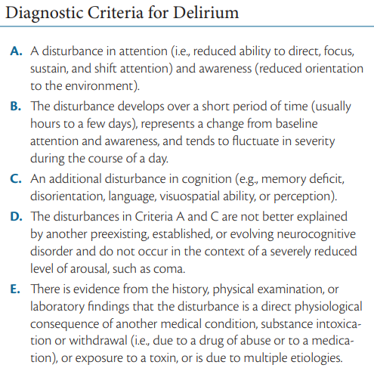

Slide 5
TREATMENT
Address underlying causes
Delirium brought on by withdrawal from alcohol or other drugs is usually treated with antipsychotic medications, which help calm the individual.
Psychosocial intervention: to reassure the individual to help him or her deal with the agitation, anxiety, and hallucinations of delirium
The presence of a family member and familiar personal belongings such as family photographs may also be an easy and comforting intervention.
Managed care and patient counseling can play significant roles in preventing delirium.

Slide 6
MAJOR AND MILD NEUROCOGNITIVE DISORDERS
Major neurocognitive disorder (previously labeled dementia) is a gradual deterioration of brain functioning that affects memory, judgment, language, and other advanced cognitive processes.
Mild neurocognitive disorder is a new DSM-5 disorder that was created to focus attention on the early stages of cognitive decline.
Agnosia - the inability to recognize and name objects, is one of the most familiar symptoms.
Facial agnosia (prosopagnosia) - the inability to recognize even familiar faces
Gradual progression
Statistics: common among older adults; more than 5% in people older than 65 and 20% to 40% in those older than 85.
Prevalent among women

Slide 7
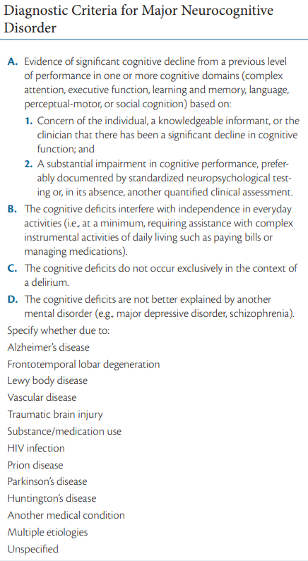
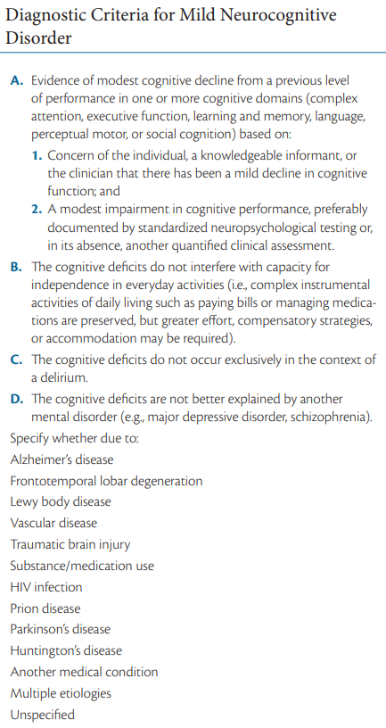

Slide 8
Classes of Neurocognitive Disorder based on etiology
Alzheimer’s Disease
Vascular Injury
Frontotemporal Degeneration
Traumatic Brain Injury
Lewy Body Disease
Parkinson’s Disease
HIV Infection
Substance Use
Huntington’s Disease
Prion Disease
Another Medical Condition

Slide 9
Alzheimer’s Disease
named after the German psychiatrist Alois Alzheimer
first described as a “strange disease of the cerebral cortex”
Symptoms includes impairment of memory, orientation, judgment, and reasoning. The inability to integrate new information results in failure to learn new associations; tend to lose interest in others and, as a result, become more socially isolated.
As the disorder progresses, they can become agitated, confused, depressed, anxious, or even combative.
Aphasia - difficulty with language
Apraxia - impaired motor functioning
Agnosia - failure to recognize objects

Slide 10
Alzheimer’s Disease
Cognitive impairments have a serious negative impact on social and occupational functioning.
It is the leading cause of neurocognitive disorder.
Common onset: ≈ 60s or 70s
Early onset: ≈ 40s or 50s
Approximately 50% of the cases of neurocognitive disorder are found to be the result of Alzheimer’s disease.
Prevalent among women

Slide 11
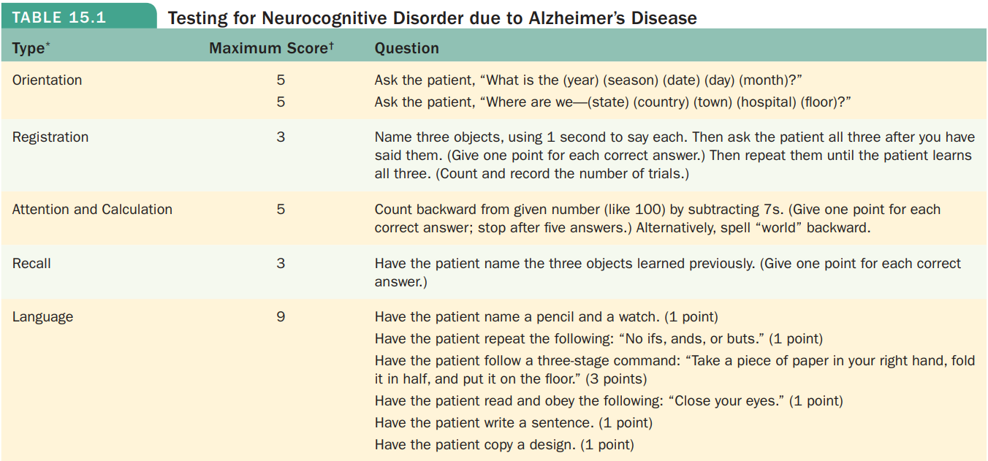
Notes:
• Sample of Mini Mental State Inpatient Consultation Form which is used to assess language and memory impairments

Slide 12
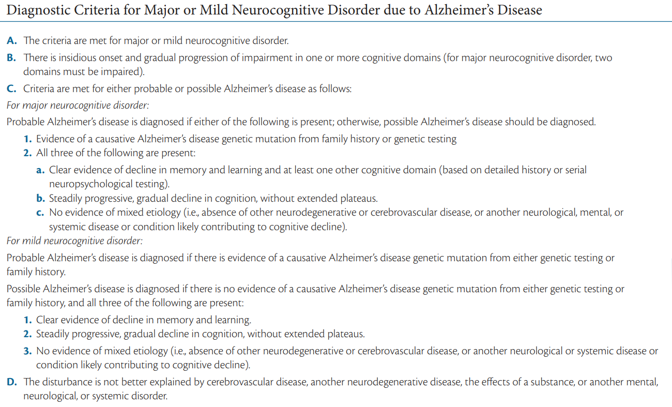

Slide 13
Vascular Neurocognitive Disorder
It is a progressive brain disorder that is one of the more common causes of neurocognitive deficits.
Vascular refers to blood vessels; neurocognitive disorder that is a result of stroke.
Cognitive disturbances such as declines in speed of information processing and executive functioning (e.g., complex decision-making)
More sudden onset than Alzheimer’s disease
Statistics: approximately 1.5% in people 70 to 75 years of age and increases to 15% for those over the age of 80
Slightly higher risk for men than women

Slide 14
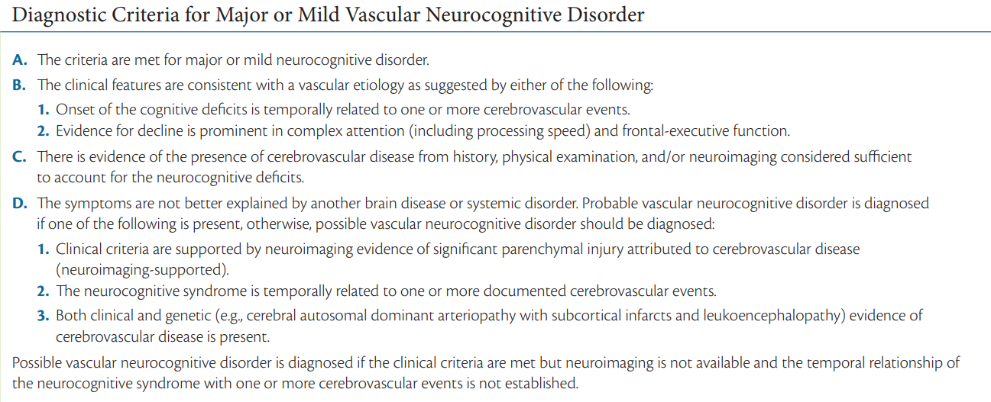

Slide 15
Frontotemporal Neurocognitive Disorder
It is a term used to categorize a variety of brain disorders that damage the frontal or temporal regions of the brain—areas that affect personality, language, and behavior.
Declines in appropriate behavior (e.g., socially inappropriate actions, apathy, making poor judgments) or language (e.g., problems with speech, finding the right word, naming objects)
Approximately 20%–25% of cases of frontotemporal NCD occur in individuals older than 65 years

Slide 16
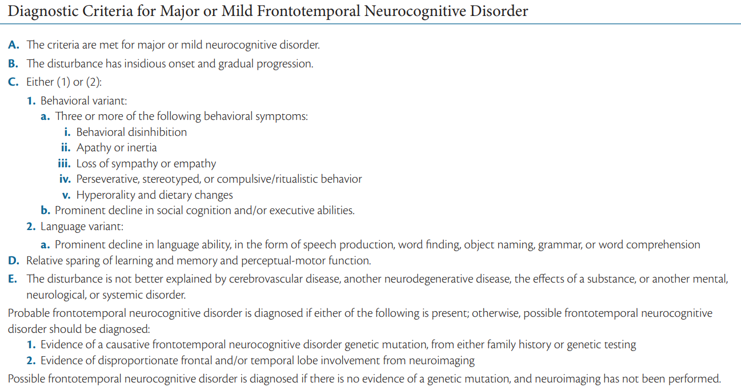

Slide 17
Traumatic Brain Injury
It includes symptoms that persist for at least a week following the trauma, including executive dysfunction (e.g., difficulty planning complex activities) and problems with learning and memory
Greatest risk for TBI are teens and young adults
Traffic/vehicular accidents, assaults, falls, and suicide attempts are common causes, as is being exposed to bomb blasts in combat.

Slide 18
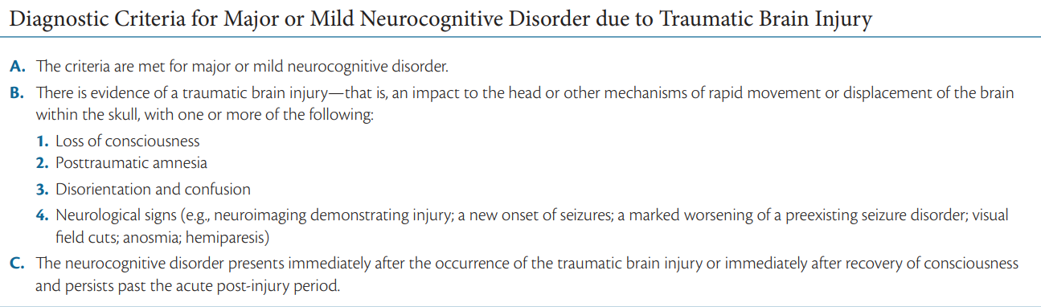

Slide 19
Lewy body disease
It is the second most common type of neurocognitive disorders (after Alzheimer’s disease).
Lewy bodies are microscopic deposits of a protein that damage brain cells over time.
The signs of this disorder come on gradually and include impairment in alertness and attention, vivid visual hallucinations, and motor impairment.
The male-to-female ratio is approximately 1.5:1.

Slide 20
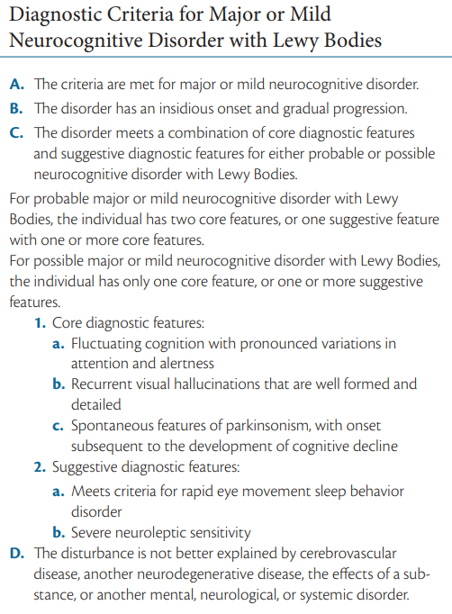

Slide 21
Parkinson’s disease
result of damage to dopamine pathways
Motor problems are characteristic among people with Parkinson’s disease, who tend to have stooped posture, slow body movements (called bradykinesia), tremors, and jerkiness in walking, afflicted individuals speak in a soft monotone
a degenerative brain disorder that affects about 100 to 300 people in every 100,000 people worldwide
more common in males than in females.

Slide 22
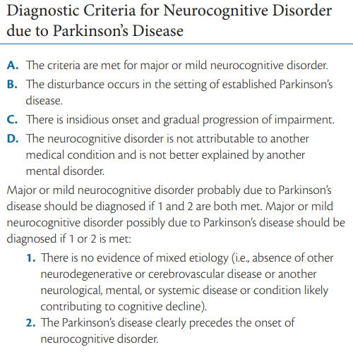

Slide 23
Human Immunodeficiency Virus Type 1 (HIV-1)
Also referred to as subcortical dementia, because it affects the cortex.
Caused by HIV infection itself
Early symptoms includes cognitive slowness, impaired attention, and forgetfulness. Affected individuals also tend to be clumsy, shows tremors and leg weakness, and become apathetic and socially withdrawn.
Likely to experience severe depression and anxiety.
≈ 25% of individuals with HIV will have signs and symptoms that meet criteria for mild NCD

Slide 24
Huntington’s disease
genetic disorder that initially affects motor movements (e.g., impaired gait), typically in the form of chorea, involuntary limb movements
42.5% of new Huntington’s disorder cases also present with mild cognitive impairment
worldwide prevalence of ≈2.7 per 100,000
average age is approximately 40 years

Slide 25
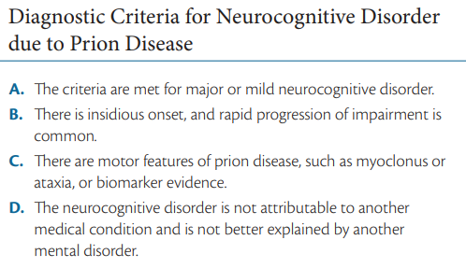
Prion Disease
rare progressive neurodegenerative disorder caused by “prions”—proteins that can reproduce themselves and cause damage to brain cells leading to neurocognitive decline
Ataxia – impaired gait

Slide 26
Substance/Medication-Induced Neurocognitive Disorder
50% to 70% of chronic heavy alcohol users show cognitive impairment
Symptoms include memory impairment and at least one of the following cognitive disturbances: aphasia (language disturbance), apraxia (inability to carry out motor activities despite intact motor function), agnosia (failure to recognize or identify objects despite intact sensory function), or a disturbance in executive functioning (such as planning, organizing, sequencing, and abstracting)

Slide 27
Causes
Biological
Genetic factors
head trauma
some diseases (e.g., hypertension, stroke)
Exposure to drugs and/or substance (e.g., alcohol, inhalants, and sedative, hypnotic, and anxiolytic drugs)
Psychological and Social influences
person’s lifestyle (e.g., substance abuse can lead to neurocognitive disorder)
Studies suggests that occupational safety (such as protecting workers from head injuries) and economic conditions influencing diet also affect the prevalence of certain forms of neurocognitive disorders
Notes:
• psychological and biological stressors may interact with physiological processes

Slide 28
Treatment
No known treatment
Researchers are also looking into the possible benefits of transplanting stem cells
Goals: (1) trying to prevent certain conditions, such as substance abuse or strokes, that may bring on neurocognitive disorder; (2) trying to delay the onset of symptoms to provide better quality of life; and (3) attempting to help these individuals and their caregivers cope with the advancing deterioration
Michelle Bourgeois (2007) created “memory wallets” to help people with Alzheimer’s disease.
Cognitive stimulation
Notes:
4th bullet: Michelle Bourgeois (2007) created “memory wallets” to help people with Alzheimer’s disease carry on conversations. On white index cards inserted into a plastic wallet are printed declarative statements such as, “My husband John and I have 3 children,” or “I was born on January 6, 1921, in Manila City.” Use this memory aid to improve their conversations with others
5th bullet: Cognitive stimulation—encouraging people with neurocognitive disorder to practice learning and memory skills—seems to be an effective method for delaying the onset of the more severe cognitive effects of this disorder. These activities include word games, tests of memory of famous and familiar faces, and practice with numbers

Slide 29
SUBSTANCE-RELATED DISORDERS
It is associated with the abuse of drugs and other substances people take to alter the way they think, feel, and behave.
9.7% of the general population (12 years or older) are believed to use illegal drugs.
Substance refers to chemical compounds that are ingested to alter mood or behavior.
Substance use is the ingestion of psychoactive substances in moderate amounts that does not significantly interfere with social, educational, or occupational functioning
Substance intoxication refers to the undesirable behavioral or psychological changes that develop during or shortly after the ingestion of a substance; includes the type of drug taken, the amount ingested, and the person’s individual biological reaction.

Slide 30
SUBSTANCE-RELATED DISORDERS
Substance dependence refers to the maladaptive pattern of substance use characterized by the need for increased amounts to achieve the desired effect, negative physical effects when the substance is withdrawn, unsuccessful efforts to control its use, and substantial effort expended to seek it or recover from its effects.
Tolerance is the brain and body’s need for larger doses of a drug to produce earlier effects.
Withdrawal is the negative physical response when the substance is no longer ingested. Withdrawal from many substances can bring on chills, fever, diarrhea, nausea and vomiting, and aches and pains.

Slide 31
Categories of Substance-related Disorders
Depressants: These substances result in behavioral sedation and can induce relaxation. They include alcohol, barbiturates, and benzodiazepines
Stimulants: These substances cause us to be more active and alert and can elevate mood. Included in this group are amphetamines, cocaine, nicotine, and caffeine
Opiates: The major effect of these substances is to produce analgesia temporarily (reduce pain) and euphoria. Heroin, opium, codeine, and morphine are included in this group.
Hallucinogens: These substances alter sensory perception and can produce delusions, paranoia, and hallucinations. Cannabis and LSD are included in this category.
Other drugs of abuse: includes inhalants, anabolic steroids, and other over-the-counter and prescription medications.

Slide 32
Alcohol-related Disorders
Impaired judgment and motor coordination (staggering, slurred speech), reaction time is slowed, confused, and even vision and hearing can be negatively affected.
Withdrawal from chronic alcohol use typically includes hand tremors, nausea or vomiting, anxiety, transient hallucinations, agitation, insomnia, and delirium tremens, a condition that can produce frightening hallucinations and body tremors.
Wernicke-Korsakoff syndrome - results in confusion, loss of muscle coordination, and unintelligible speech. It is caused by a deficiency of thiamine, a vitamin metabolized poorly by heavy drinkers.

Slide 33
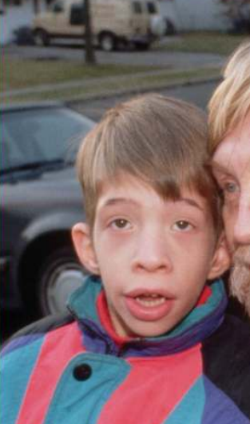
Alcohol-related Disorders
Fetal alcohol syndrome (FAS) - includes fetal growth retardation, cognitive deficits, behavior problems, and learning difficulties.
Physical characteristics of children with FAS include skin folds at the corners of the eyes, low nasal bridge, short nose, no groove between nose and upper lip, small head circumference, small eye opening, small midface, and thin upper lip.

Slide 34
Alcohol-related Disorders
Lifetime prevalence of 29%
Stages of Alcohol use (Jellinek, 1952):
prealcoholic stage - drinking occasionally with few serious consequences
prodromal stage - drinking heavily but with few outward signs of a problem
crucial stage - loss of control, with occasional binges
chronic stage - the primary daily activities involve getting and drinking alcohol
Notes:
Numerous studies have found that many people who commit such violent acts as murder, rape, and assault are intoxicated at the time of the crime.
Alcohol does not cause aggression, but it may increase a person’s likelihood of engaging in impulsive acts and it may impair the ability to consider the consequences of acting impulsively

Slide 35
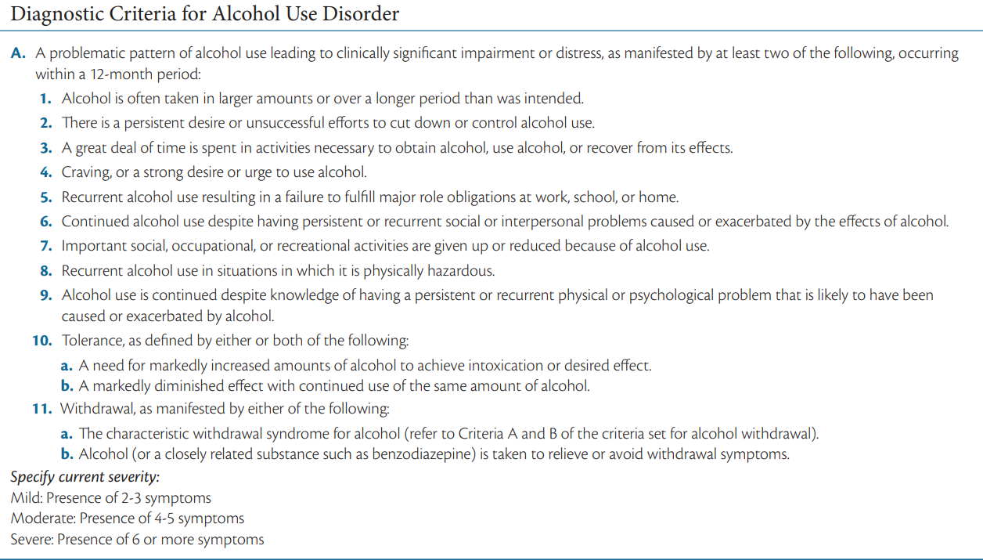

Slide 36
Sedative-, Hypnotic-, or Anxiolytic-Related Disorders
sedative (calming), hypnotic (sleep-inducing), and anxiolytic (anxiety-reducing) drugs
Barbiturates - prescribed to help people sleep and replaced such drugs as alcohol and opium
Benzodiazepines - primarily to reduce anxiety muscle relaxants
Overdosing on barbiturates is a common means of suicide
Females are more likely to seek help than men

Slide 37
Stimulant-Related Disorders
Amphetamines
Can induce feelings of elation and vigor and can reduce fatigue; after a period of elevation, however, you come back down and “crash,” feeling depressed or tired; also reduce appetite
Prescribed for people with narcolepsy and ADHD (e.g., Ritalin, Adderall)
Methylene-dioxymethamphetamine (MDMA) or commonly known as ecstasy is used as an appetite suppressant but is now often used as a club drug.
Methamphetamine (a.k.a “crystal meth” or “ice”) – a purified, crystallized form of amphetamine; ingested through smoking; this drug causes marked aggressive tendencies and stays in the system longer than cocaine, making it particularly dangerous.
Amphetamines stimulate the central nervous system by enhancing the activity of norepinephrine and dopamine.
↑ amphetamine = ↑ dopamine and norepinephrine → hallucinations and delusions

Slide 38
Stimulant-Related Disorders
Cocaine
relief from hunger and fatigue
increases alertness, produces euphoria, increases blood pressure and pulse, and causes insomnia and loss of appetite
Worldwide, almost 5% of adults report using cocaine at some point in their lives.
Those aged 18 to 25 are about twice as likely to use cocaine compared with other age groups.
Men are twice as likely to use cocaine as women.
The “up” seems to come primarily from the effect of cocaine on the dopamine system. This stimulation of the dopamine neurons in the “pleasure pathway” causes the high associated with cocaine use.

Slide 39
Stimulant-Related Disorders
Nicotine
Withdrawal symptoms include depressed mood, insomnia, irritability, anxiety, difficulty concentrating, restlessness, and increased appetite and weight gain
Only 7 to 19 seconds after a person inhales the smoke, the nicotine reaches the brain
Smoking has been linked with signs of negative affect, such as depression, anxiety, and anger.
Genetic studies suggest that a genetic vulnerability combined with certain life stresses may combine to make you vulnerable to both a nicotine use disorder and depression

Slide 40
Stimulant-Related Disorders
Caffeine
It is the most common of the psychoactive substances
Called the “gentle stimulant” because it is thought to be the least harmful of all addictive drugs
Found in tea, coffee, many soda drinks, and cocoa products.
Caffeine seems to block adenosine reuptake. Adenosine plays an important role on the release of dopamine and glutamate, which may explain the elation and increased energy that come with caffeine use.

Slide 41
Opioid-Related Disorders
Opiate refers to the natural chemicals that have a narcotic effect - relieve pain and induce sleep
Opioids refers to the family of substances that includes natural opiates, synthetic variations (heroin, methadone, hydrocodone, oxycodone)
Research suggests that mortality rates in this population range from 6 to 20 times higher than the general population’s
Persistence opioid use may be related to comorbid psychological disorders and sexual or physical abuse

Slide 42
Hallucinogen-Related Disorders
LSD (d-lysergic acid diethylamide), sometimes referred to as “acid,” is the most common hallucinogenic drug
Psilocybin is found in certain species of mushrooms
Perceptual changes such as the subjective intensification of perceptions, depersonalization, and hallucinations. Physical symptoms include pupillary dilation, rapid heartbeat, sweating, and blurred vision
People do report having “bad trips”; these are the sort of frightening episodes in which clouds turn into threatening monsters or deep feelings of paranoia take over

Slide 43
Hallucinogen-Related Disorders
Cannabis
Marijuana is the name given to the dried parts of the cannabis or hemp plant; aka “weed.”
People who smoke marijuana often experience altered perceptions of the world and is believed to alter mood and behavior
Normal experiences seem extremely funny, or the person might enter a dreamlike state in which time seems to stand still. Users often report heightened sensory experiences and seeing vivid colors
Research on frequent cannabis users suggests that impairments of memory, concentration, relationships with others, and employment may be negative outcomes of long-term use

Slide 44
Other Drugs of Abuse
Inhalants
Include a variety of substances found in volatile solvents—making them available to breathe into the lungs directly
Inhalant use is highest during early adolescence, ages 13 to 14
Can increase aggressive and antisocial behavior
Steroids
The legitimate medical uses of these drugs focus on people with asthma, anemia, breast cancer, and males with inadequate sexual development
Used to enhance performance and body size
Other Medications

Slide 45
CAUSES
Biological
Researchers conducting twin, family, and adoption and other genetic studies have found that certain people are genetically vulnerable to drug abuse
Psychological
Positive reinforcement – drugs taken gives pleasurable feeling or experience
Negative reinforcement – drugs help remove unpleasant experiences such as pain, feelings of illness, or anxiety. For instance, we take aspirin not because it makes us feel good but because it stops us from feeling bad.
Opponent-process theory - an increase in positive feelings will be followed shortly by an increase in negative feelings. Similarly, an increase in negative feelings will be followed by a period of positive feelings.
Notes:
Positive reinforcement in the use and the situations surrounding the use of drugs contributes to whether or not people decide to try to continue using drugs
Many people are likely to initiate and continue drug use to escape from unpleasantness in their lives. In addition to the initial euphoria, many drugs provide escape from physical pain (opiates), from stress (alcohol), or from panic and anxiety (benzodiazepines).

Slide 46
CAUSES
Cognitive
Expectancy effect - what people expect to experience when they use drugs influences how they react to them
Studies suggest that adolescents may begin drinking or using other drugs partly because they believe these substances will have positive effects
Social
Peer pressure and Media
Drug use is seen as a failure of self-control in the face of temptation
Cultural
Cultural norms affect the rates of substance use.
In Korea, people are expected to drink alcohol heavily on certain social occasions

Slide 47
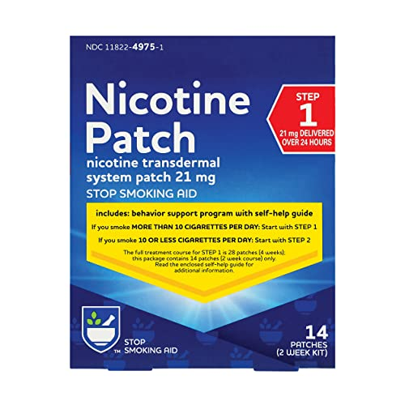
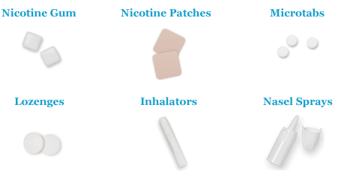
TREATMENT
it is estimated that fewer than 25% of the people who have significant problems with substance use seek treatment for their problems
the first step is to help someone through the withdrawal process; typically, the ultimate goal is abstinence
teach skills for coping with life stressors
Agonist substitution involves providing the person with a safe drug that has a chemical makeup similar to the addictive drug
Methadone is an opiate agonist that is often given as a heroin substitute
Nicotine is provided to smokers in the form of gum, patch, inhaler, or nasal spray, which lack the carcinogens included in cigarette smoke.

Slide 48

TREATMENT
Antagonist treatments: drugs block or counteract the effects of psychoactive drugs, it produces immediate withdrawal symptoms
They do appear to help some drug abusers handle withdrawal symptoms and the cravings that accompany attempts to abstain from drug use.
Aversive treatment: prescribe drugs that make ingesting the abused substances extremely unpleasant; For instance, the use of disulfiram (Antabuse) with people who have an alcohol use disorder.
Alcoholics Anonymous (AA) – more common in western countries; the goal is to provide social support through group meetings.
Cognitive-behavioral therapy (CBT) - addresses the problem of relapse

Slide 49

GAMBLING DISORDER
Studies have found that the ventromedial prefrontal cortex and orbitofrontal cortex do not function as normal in those with gambling disorder. Poor impulse control and risky decisions are both processes that involve ventromedial prefrontal cortex and those individuals with higher problems in these areas also show poorer response to treatment and higher relapse rates.
Characteristics: denial of the problem, impulsivity, and continuing optimism (“One big win will cover my losses!”)

Slide 50
Impulse-Control Disorders
Intermittent Explosive Disorder
Have episodes in which they act on aggressive impulses that result in serious assaults or destruction of property.
Lifetime prevalence of 7.3%
Recent studies have proposed that there is a disruption of the orbital frontal cortex’s in inhibiting amygdala activation combined with changes in the serotonin system in those with this disorder.

Slide 51
Impulse-Control Disorders
Kleptomania
A recurrent failure to resist urges to steal things that are not needed for personal use or their monetary value
More common in women than in men and that it typically starts in adolescence
People with kleptomania score high on assessments of impulsivity, reflecting their inability to judge the immediate gratification of stealing compared with the long-term negative consequences.
Patients with kleptomania often report having no memory (amnesia) about the act of shoplifting

Slide 52
Impulse-Control Disorders
Pyromania
Involves being preoccupied with fires and the associated equipment involved in setting and putting out these fires.
Pyromania is diagnosed in only about 3% of arsonists
Treatment is generally cognitive-behavioral and involves helping the person identify the signals that initiate the urges and teaching coping strategies to resist the temptation to start fires.

Slide 53
Schizophrenia
characterized by a broad spectrum of cognitive and emotional dysfunctions including delusions and hallucinations, disorganized speech and behavior, and inappropriate emotions
Eugen Bleuler coined the term schizophrenia, which comes from the combination of the Greek words for “split” (skhizein) and “mind” (phren)
4 A’s of Schizophrenia:
(1) affective disturbance
(2) ambivalence
(3) autism
(4) disturbance of thought association

Slide 54
Schizophrenia
Diagnosis of schizophrenia requires that two or more positive, negative, and/or disorganized symptoms be present for at least 1 month, with at least one of these symptoms including delusions, hallucinations, or disorganized speech.
Severity of symptoms:
0 - symptom is not present
1 - equivocal evidence (i.e., not sure)
2 - present but mild
3 - present and moderate
4 - present and severe

Slide 55
Phases of Schizophrenia
1. Premorbid - individual’s functioning prior to the disorder
2. Prodromal - a 1 to 2-year period before the serious symptoms occur but when less severe yet unusual behaviors start to show themselves such as ideas of reference and magical thinking
3. Active – a.k.a “onset phase”, positive, negative or disorganized symptoms are “full-blown”
4. Residual – periods of remission, could be partial or complete.

Slide 56
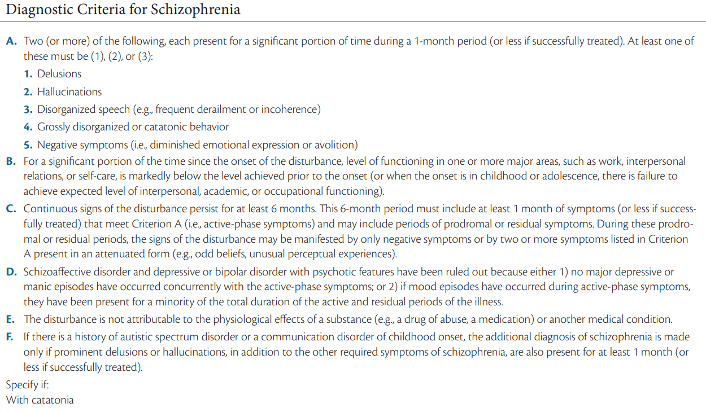

Slide 57
Positive Symptoms
Delusions
Delusion of grandeur - a mistaken belief that the person is famous or powerful
Delusion of persecution - others are “out to get them.”
Capgras, syndrome - the person believes someone he or she knows has been replaced by a double
Cotard’s syndrome - the person believes he or she is dead
Motivational view - beliefs are attempts to deal with and relieve anxiety and stress.
Deficit view - sees these beliefs as resulting from brain dysfunction that creates these disordered cognitions or perception.
Notes:
Positive symptoms refer to symptoms around distorted reality
Delusion - having beliefs that are unrealistic, bizarre, and not shared by others in the same culture.

Slide 58
Positive Symptoms
Hallucinations
Experience of sensory events without any input from the surrounding environment
Auditory hallucination is the most common form experienced by people with schizophrenia
People who experience hallucinations appear to have intrusive thoughts, but they believe they are coming from somewhere or someone else
Broca’s area – part of the brain most active during hallucinations; is known to be involved in speech production
Wernicke’s area – involves in language comprehension; people who are hallucinating are not hearing the voices of others but are listening to their own thoughts or their own voices and cannot recognize the difference

Slide 59
Example of Alogia:
Interviewer: Do you have any children?
Client: Yes.
I: How many children do you have?
C: Two.
I: How old are they?
C: Six and twelve.

Slide 60
NEGATIVE SYMPTOMS
Avolition is the inability to initiate and persist in activities; people with this symptom show little interest in performing even the most basic day-to-day functions, including those associated with personal hygiene.
Alogia refers to the relative absence of speech
Anhedonia is the presumed lack of pleasure
Asociality refers to the lack of interest in social interaction
Affective Flattening is a symptom wherein individuals do not show emotions when you would normally expect them to.
Notes:
Negative symptoms involve deficits in normal behavior in such areas as speech, blunted affect (or lack of emotional reactivity), and motivation.
2nd bullet: A person with alogia may respond to questions with brief replies that have little content and may appear uninterested in the conversation; Some researchers, for example, suggest that people with alogia may have trouble finding the right words to formulate their thoughts; Sometimes alogia takes the form of delayed comments or slow responses to questions.
5th bullet: They may stare at you vacantly, speak in a flat and toneless manner, and seem unaffected by things going on around them; represent difficulty expressing emotion, not a lack of feeling.

Slide 61
DISORGANIZED SYMPTOMS
These include a variety of erratic behaviors that affect speech, motor behavior, and emotional reactions.
Disorganized Speech - people with schizophrenia often lack insight and awareness that they have a problem.
Tangentiality - going off on a tangent instead of answering a specific question.
Loose association or derailment - abruptly changes the topic of conversation to unrelated areas
Inappropriate affect - laughing or crying at improper times.
Disorganized behavior - exhibit bizarre behaviors in public
catatonic immobility - people hold unusual postures, as if they were fearful of something terrible happening if they moved
waxy flexibility - the tendency to keep their bodies and limbs in the position they are put in by someone else
Notes:
4th bullet: they jump from topic to topic, and usually talk illogically.

Slide 62
Other Psychotic Disorders
Schizophreniform disorder
Schizoaffective disorder
Delusional disorder
Shared psychotic disorder (folie à deux)
Brief Psychotic disorder
Attenuated Psychosis Syndrome

Slide 63
Schizophreniform disorder
Lifetime prevalence is approximately 0.2%
The diagnostic criteria includes onset of psychotic symptoms within 4 weeks of the first noticeable change in usual behavior, confusion at the height of the psychotic episode, good premorbid (before the psychotic episode) social and occupational functioning, and the absence of blunted or flat affect.

Slide 64
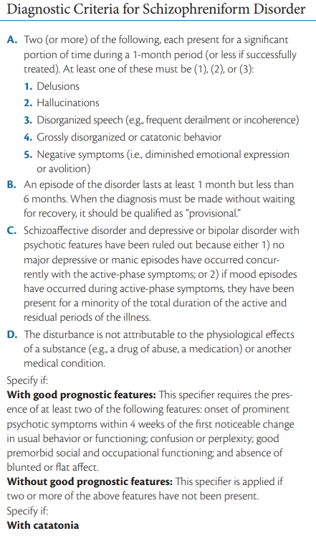

Slide 65
Schizoaffective disorder
DSM-5 criteria for schizoaffective disorder require, in addition to the presence of a mood disorder, delusions or hallucinations for at least 2 weeks in the absence of prominent mood symptoms
The prognosis is that individuals tend not to get better on their own and are likely to continue experiencing major life difficulties for many years.

Slide 66
Delusional disorder
Persistent belief that is contrary to reality, in the absence of other characteristics of schizophrenia; they may become socially isolated because they are suspicious of others.
The delusions are often long-standing, sometimes persisting over several years.
In delusional disorder, the imagined events could be happening but aren’t (e.g., mistakenly believing you are being followed); In schizophrenia, imagined events are outside the realm of possibility.
Delusional subtypes:
erotomania - the irrational belief that one is loved by another person, usually of higher status.
grandiose - involves believing in one’s inflated worth, power, knowledge, identity, or special relationship to a deity or famous person.
jealous - believes the sexual partner is unfaithful.
persecutory - involves believing oneself (or someone close) is being malevolently treated in some way.
somatic - the person feels afflicted by a physical defect or general medical condition.
Notes:
4th bullet: Some individuals who stalk celebrities appear to have erotomanic delusional disorder

Slide 67
RATIONALIZATION:
The correct answer is B. Shared psychotic disorder a.k.a folie à deux is a subtype of delusional disorder that are shared by two or more individuals. In this case, Macy developed delusion as a result of being a close friend to Nancy who initially has the delusion.

Slide 68
Delusional disorder
Shared psychotic disorder (folie à deux) is the condition in which an individual develops delusions simply as a result of a close relationship with a delusional individual.
Delusional disorder seems to afflict more females than males (55% and 45%, respectively, of the affected population).
A number of other disorders can cause delusions, and their presence should be ruled out before diagnosing delusional disorder
substance-induced psychotic disorder - abuse of amphetamines, alcohol, and cocaine can cause delusions
psychotic disorder associated with another medical condition – brain tumor

Slide 69
Other Psychotic disorder
Brief Psychotic disorder
which is characterized by the presence of one or more positive symptoms such as delusions, hallucinations, or disorganized speech or behavior lasting 1 month or less
often precipitated by extremely stressful situations.
Attenuated Psychosis Syndrome
They can be at high risk for developing schizophrenia and may be at an early stage of the disorder (prodromal)
These people may have some of the symptoms of schizophrenia but are aware of the troubling and bizarre nature of these symptoms

Slide 70
CAUSES
(1) the possible genes involved in schizophrenia,
(2) the chemical action of the drugs that help many people with this disorder,
(3) abnormalities in the working of the brains of people with schizophrenia, and
(4) environmental risk factors that may precipitate the onset of the symptoms
Genetic Influence: Genes are responsible for making some individuals vulnerable to schizophrenia
Neurobiological Influences: high dopamine = positive symptoms whereas low dopamine = negative symptoms; alterations in prefrontal activity involving glutamate transmission
Notes:
Genetic influence: recent research confirms this observation and suggests that families that have a member with schizophrenia are at risk not just for schizophrenia alone or for all psychological disorders; instead, there appears to be some familial risk for a spectrum of psychotic disorders related to schizophrenia.
Neurobiological influence: Research suggests that deficient activity in a particular area of the frontal lobes, the dorsolateral prefrontal cortex (DLPFC), may be implicated in schizophrenia; When people with and without schizophrenia are given tasks that involve the DLPFC, less activity (measured by cerebral blood flow) is recorded in the brains of those with schizophrenia; DLPFC is “communicating” less with other brain regions

Slide 71
CAUSES
Psychological and Social Influences: Living in a large city is associated with an increased risk of developing schizophrenia—suggesting the stress of urban living may precipitate its onset.
Stress - activates vulnerability and increases relapse risk
Schizophrenogenic mother - used to describe a mother whose cold, dominant, and rejecting nature was thought to cause schizophrenia in her children.
double bind communication was used to portray a communication style that produced conflicting messages, which, in turn, caused schizophrenia to develop.
expressed emotion (EE) - ratings of high expressed emotion in a family are a good predictor of relapse among people with chronic schizophrenia.

Slide 72
TREATMENT
Antipsychotic medications such as neuroleptics, help people think more clearly and reduce hallucinations and delusions (e.g., risperidone and olanzapine)
transcranial magnetic stimulation - uses wire coils to repeatedly generate magnetic fields—up to 50 times per second—that pass through the skull to the brain. This input seems to interrupt temporarily the normal communication to that part of the brain
Modafinil is a cognitive enhancer with low abuse potential. This drug may improve cognitive functions, such as memory and problem solving. Some limited research also suggests that the drug may improve emotion processing in schizophrenia.

Slide 73
REFERENCES:
Barlow, D. H., Durand, V. M., & Hofmann, S. G. (2016). Abnormal Psychology: An Integrative Approach, 8th edition. Cengage Learning.
American Psychiatric Association (2013) Diagnostic and Statistical Manual of Mental Disorders (5th ed.)

